Slide 1

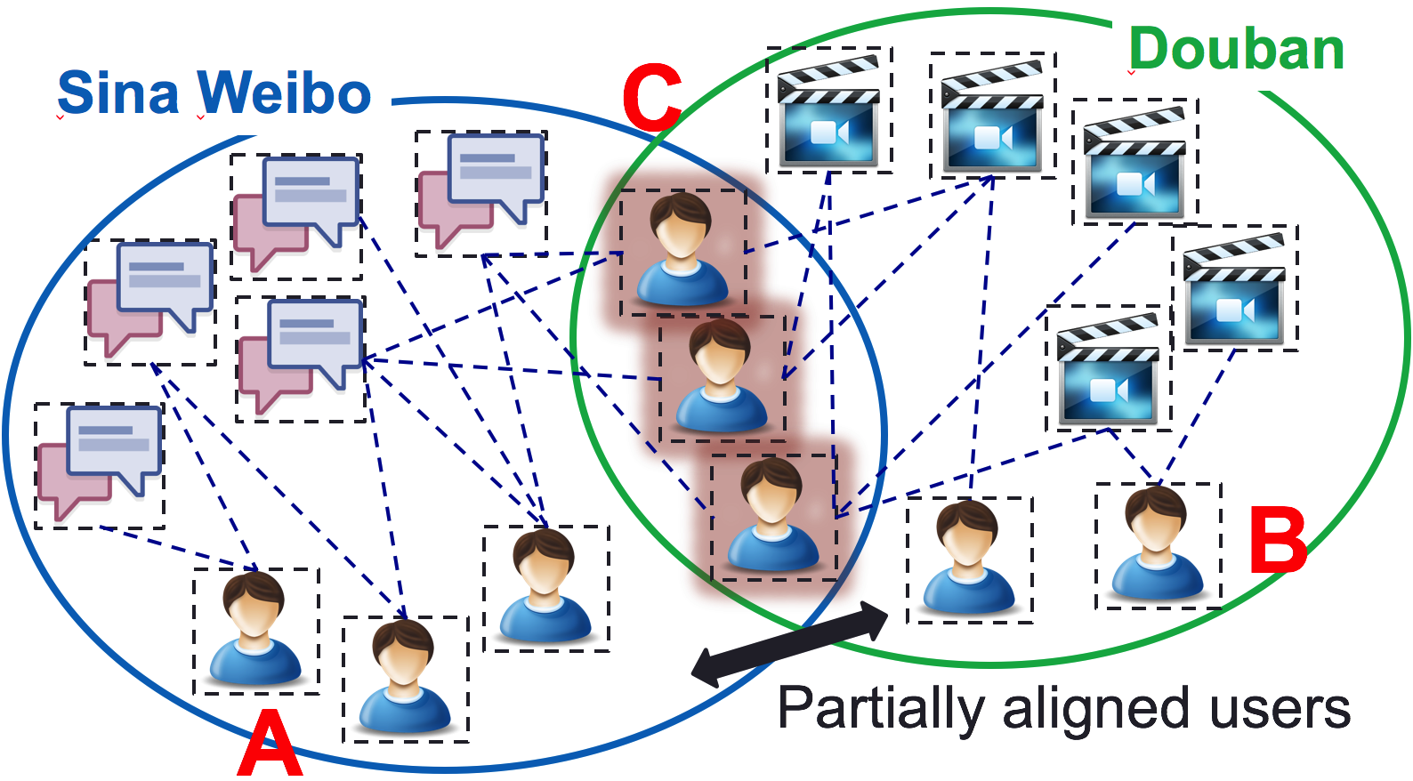


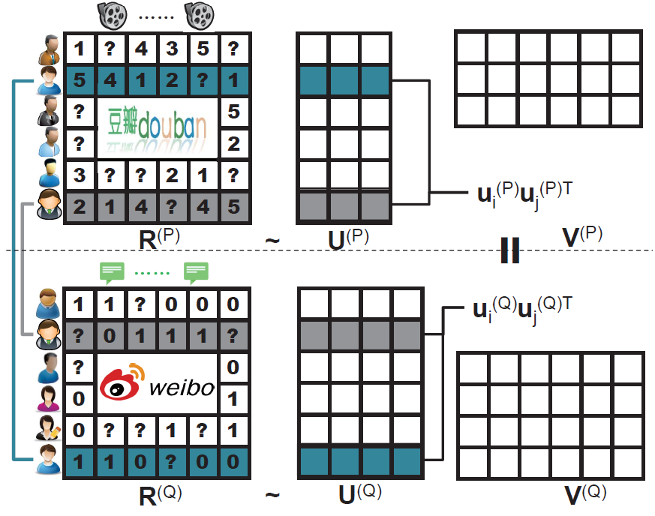
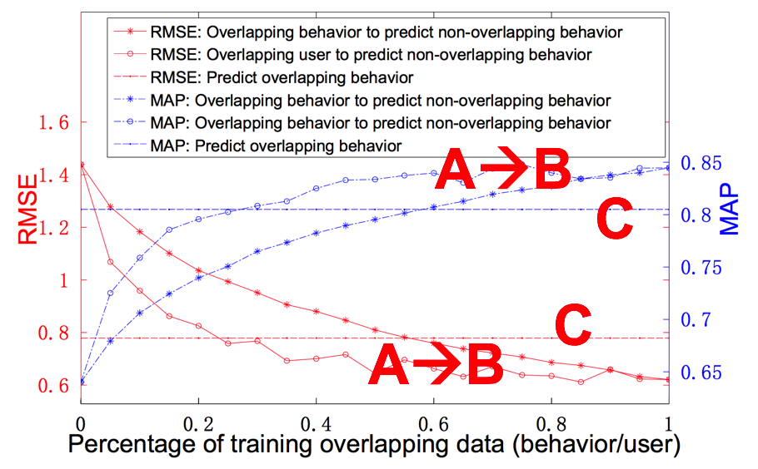
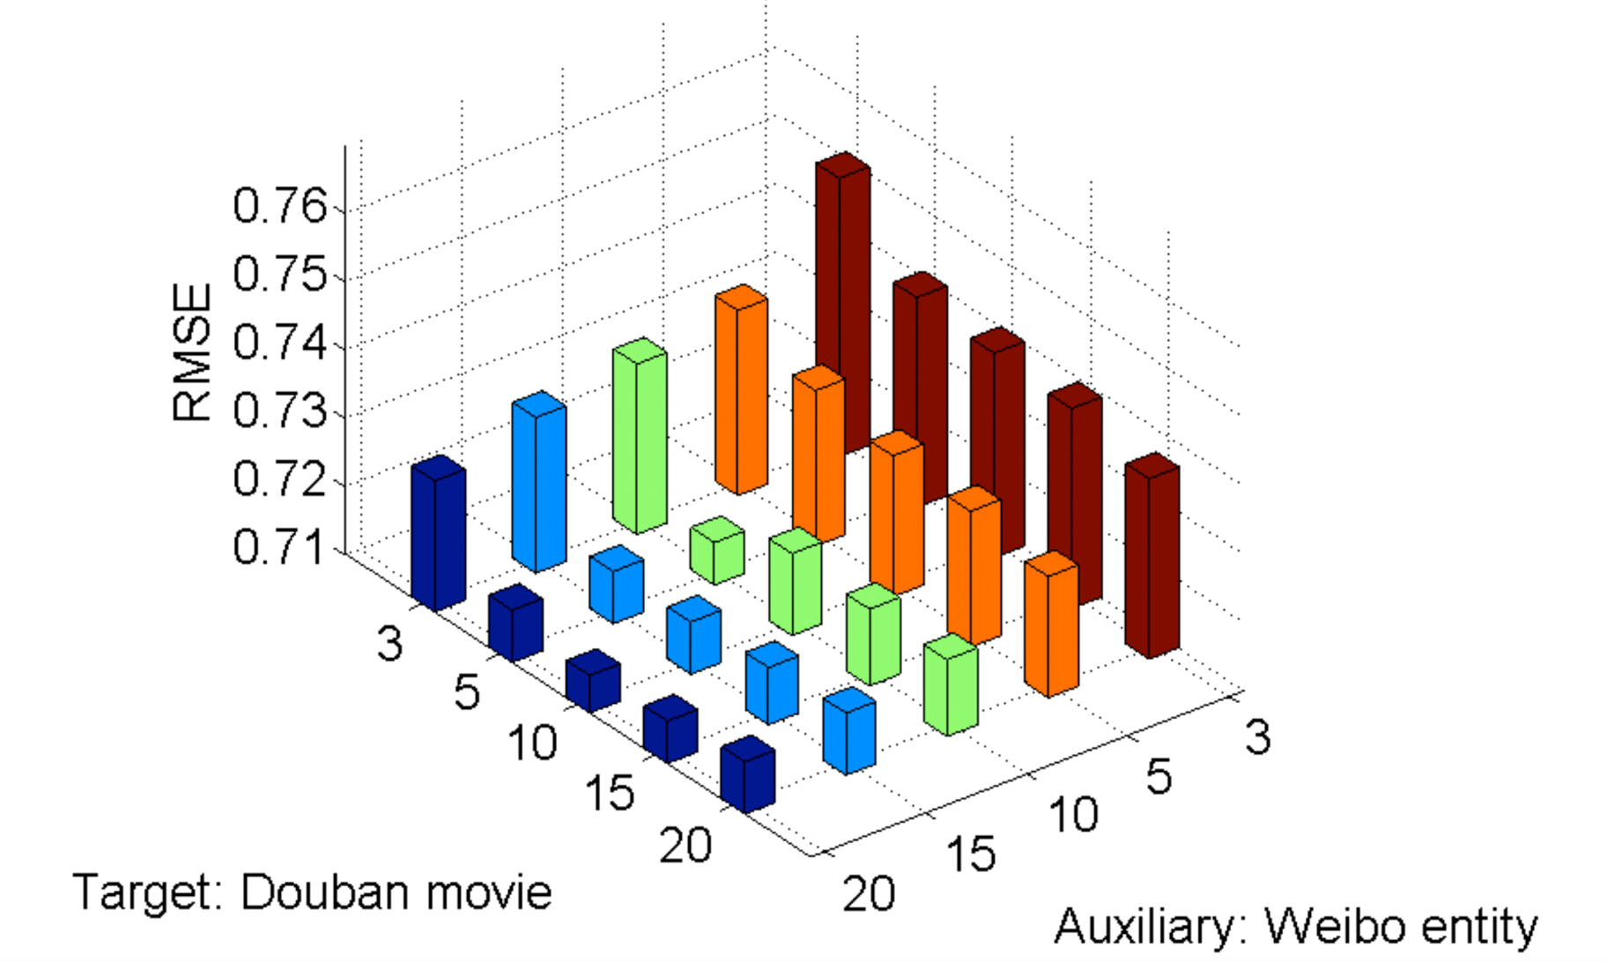
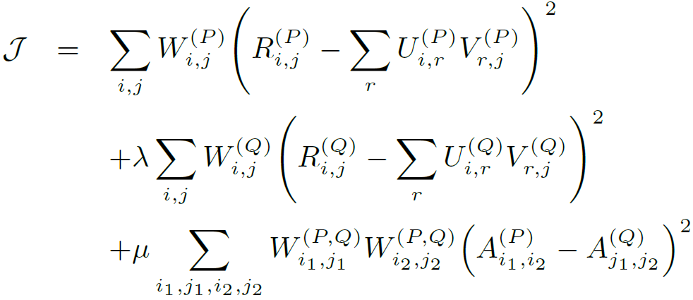

Little is Much: Bridging Cross-Platform Behaviors through Overlapped Crowds Meng Jiang¹, Peng Cui¹, Nicholas Jing Yuan², Xing Xie², Shiqiang Yang¹ ¹ Department of Computer Science and Technology, Tsinghua University, Beijing, China ² Microsoft Research Asia, Beijing, China
XPTrans
Cross-Platform Behavior Prediction
We register the Uber application with our Facebook accounts. So, can we improve the behavior prediction accuracy on Uber with the rich social data?
The key challenge in prediction is sparsity.
Knowledge transfer from auxiliary data can alleviate the sparsity problem.
Experiments
C: Overlapping users; A and B are NOT.
Q: Can we transfer the auxiliary big data A to improve the performance on sparse data B as good as richer but small data C?
Transfer but the Same Latent Space Size
Sina Weibo
tags/entities
Douban
movies/books
Sina Weibo
users
A
Douban
users
C
B
NO Transfer
Transfer via the Same
Latent Space
 | Weibo tweet entity to Douban movie
 | RMSE | MAP
A
C | 0.779 | 0.805
B | 1.439 | 0.640
 | Weibo tweet entity to Douban movie
 | RMSE | MAP
A
C | 0.757 | 0.811
B | 1.164 (-19%) | 0.702 (+9.7%)
Problem | Bridge | Method
Cross-Source | Non-overlapped User cluster × Item cluster The same latent representation | Codebook
Cross-Domain | Fully overlapped users OR Fully overlapped items User vector OR Item vector The same latent representation | CST
Cross-Platform | Partially overlapped users User vector Different latent representations | XPTrans
 | Douban book to Weibo social tag
 | RMSE | MAP
A | 0.429 | 0.464
C | 0.267 | 0.666
B
 | Douban book to Weibo social tag
 | RMSE | MAP
A | 0.411 (-4.2%) | 0.487 (+5.0%)
C | 0.256 | 0.681
B
XPTrans Framework
Semi-supervised Transfer Learning
Objective Function
Transfer via Different
Latent Spaces
Performance
Overlapping
user similarity
across platforms
as flexible
regularization
 | Weibo tweet entity to Douban movie
 | RMSE | MAP
A
C | 0.715 | 0.821
B | 0.722 (-38%) | 0.820 (+17%)
Different sizes
of Latent Space
 | Douban book to Weibo social tag
 | RMSE | MAP
A | 0.374 (-11%) | 0.533 (+12%)
C | 0.236 | 0.705
B
Target platform
Auxiliary platform
Acknowledgement
Contact: Meng Jiang
mjiang89@gmail.com
Dr. Jiang is now a postdoc at UIUC.
Overlapping user similarity
(Pair-wise regularization)

